Slide 1



Welcome you all
Course: CSS
Day 1 (Session 1)
M.Chitradevi
Technical Trainer,
KG Micro College
KGiSL Campus, Coimbatore – 641 035.

Slide 2


Slide 3
CSS is a language for specifying how documents are presented to users — how they are styled, laid out, etc.
A document is usually a text file structured using a markup language — HTML is the most common markup language, but you may also come across other markup languages such as SVG or XML.
Presenting a document to a user means converting it into a form usable by your audience. Browsers, like Firefox, Chrome, or Edge, are designed to present documents visually,.
For example, on a computer screen, projector, or printer.

Slide 4
CSS can be used for very basic document text styling .
for example, for changing the color and size of headings and links.
It can be used to create a layout .
for example, turning a single column of text into a layout with a main content area and a sidebar for related information.
It can even be used for effects such as animation.

Slide 5

CSS (Cascading Style Sheets)is used to apply styles to web pages. Cascading Style Sheets are fondly referred to as CSS.
It is used to make web pages presentable.
The reason for using this is to simplify the process of making web pages presentable. It allows you to apply styles on web pages.
More importantly, it enables you to do this independently of the HTML that makes up each web page.

Slide 6

Why we learn CSS?
Styling is an essential property for any website. It increases the standards and overall look of the website that makes it easier for the user to interact with it.
A website can be made without CSS, as styling is MUST since no user would want to interact with a dull and shabby website.
So for knowing Web Development, learning CSS is mandatory.

Slide 7
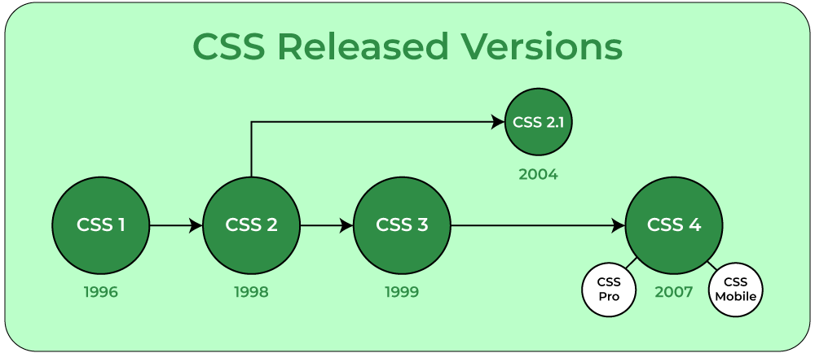

Slide 8
How CSS is different from HTML?
HTML is used to define a structure of a web page whereas CSS is used to style the web pages by using different styling features.
HTML consists of tags inside which text is enclosed and CSS consists of selectors and declaration blocks.
CSS can be internal or external depending upon the requirement.
We cannot use HTML inside a CSS sheet but we can use CSS inside an HTML document.
CSS has comparatively higher backup and support than HTML.

Slide 9
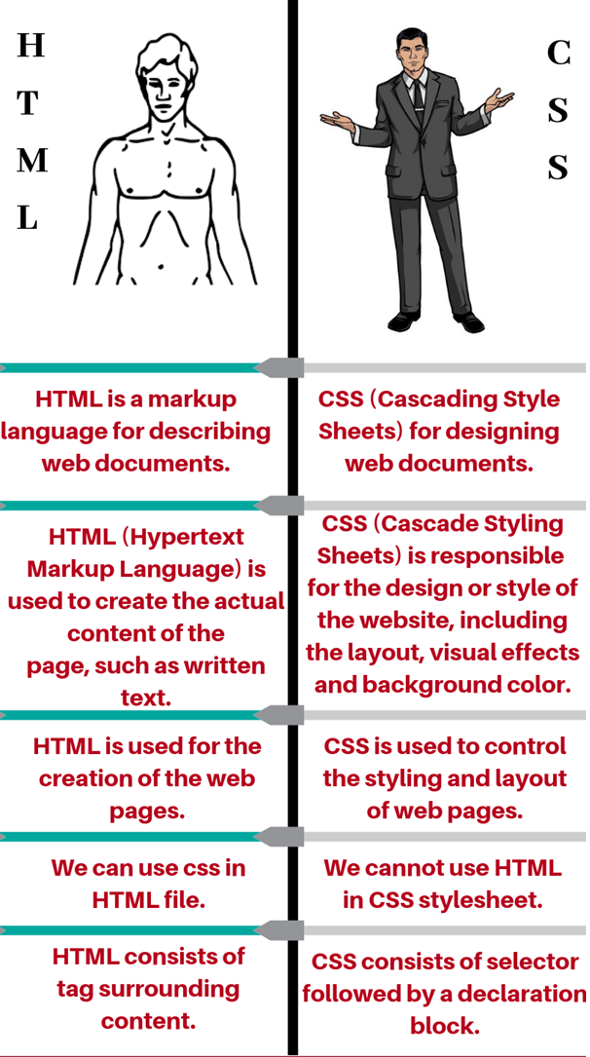

Slide 10
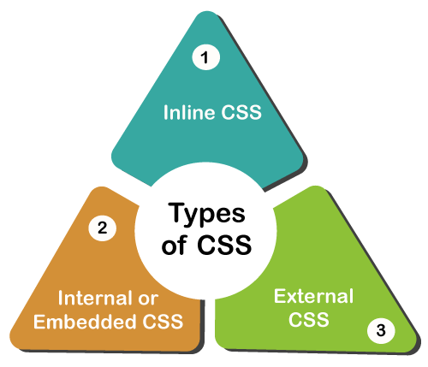

Slide 11
Inline: Inline CSS contains the CSS property in the body section attached with the element known as inline CSS.
Internal or Embedded: The CSS ruleset should be within the HTML file in the head section i.e the CSS is embedded within the HTML file.
External: External CSS contains a separate CSS file that contains only style property with the help of tag attributes.

Slide 12
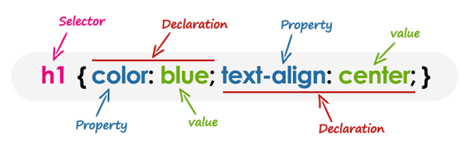
CSS Syntax
Understanding CSS Syntax
A CSS stylesheet consists of a set of rules that are interpreted by the web
browser and then applied to the corresponding elements such as paragraphs,headings, etc. in the document.
A CSS rule have two main parts, a selector and one or more declarations:

Slide 13
Inline
When you use inline, snippets of CSS are written directly into the HTML code and applied to only a single line of code.
<h2 style=”font-size:22px;color:green;”>This is a headline.</h2>
This line of code makes one specific headline on a .html page green and in 22 point font.

Slide 14
Internal
Internal is CSS instructions written directly into the header of the .html page. You want to go this route if one page on your website is going to have its own unique look separate from the rest of your site.
<head> <style>
body {background-color:orange;} p {font-size:24px; color:white;}
</style> </head>
This page will have an orange background with paragraphs sized at 24 point and white font.

Slide 15
External
External CSS is saved as .css files and can be used to determine the appearance of the entire website with just one file.
To use, your .html files need to include a header section that links to the external sheet. It would look like this:
<head> <link rel=”stylesheet” type=”text/css” href=style.css”> </head>
In this case, style.css is the external style sheet.
External is the efficient method for implementing CSS on a website, plus it’s easy to keep track and implement style.

Slide 16
Inside a subdirectory called styles inside the current directory
<link rel="stylesheet" href="styles/style.css" />
Inside a subdirectory called general, which is in a subdirectory called styles, inside the current directory
<link rel="stylesheet" href="styles/general/style.css" />
Go up one directory level, then inside a subdirectory called styles
<link rel="stylesheet" href="../styles/style.css" />

Slide 17
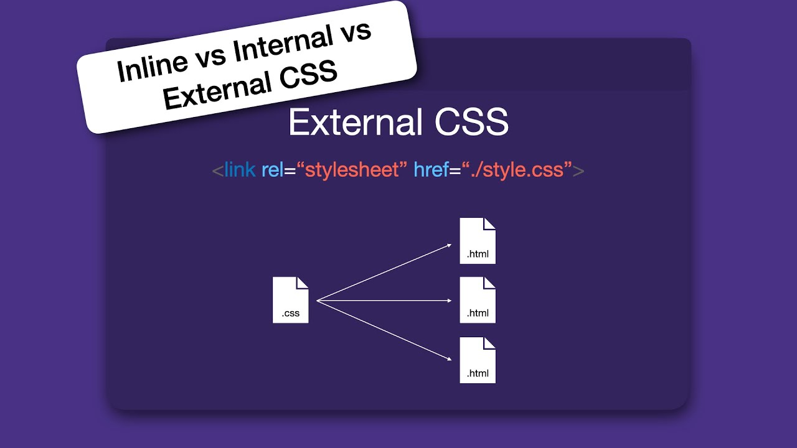

Slide 18
Internal
<head> <style>
body {background-color:orange;} p {font-size:24px; color:white;}
</style> </head>
Inline
<h2 style=”font-size:22px;color:green;”>This is a headline.</h2>

Slide 19
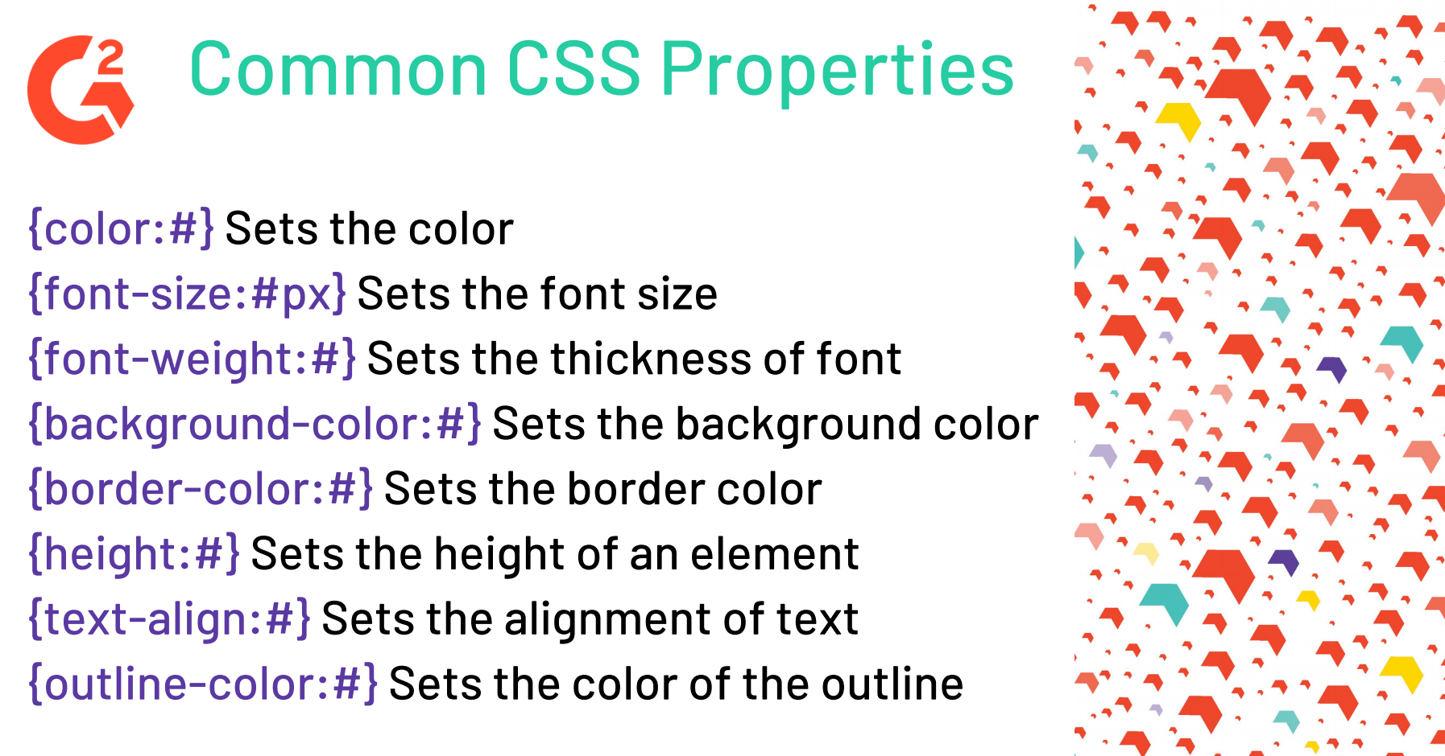

Slide 20
What is Selector?
A CSS selector is a pattern to match the elements on a web page.
The style rules associated with that selector will be applied to the elements that match the selector pattern.
Selectors are one of the most important aspects of CSS as they allow you to target specific elements on your web page in various ways so that they can be styled.
Several types of selectors are available in CSS.

Slide 21
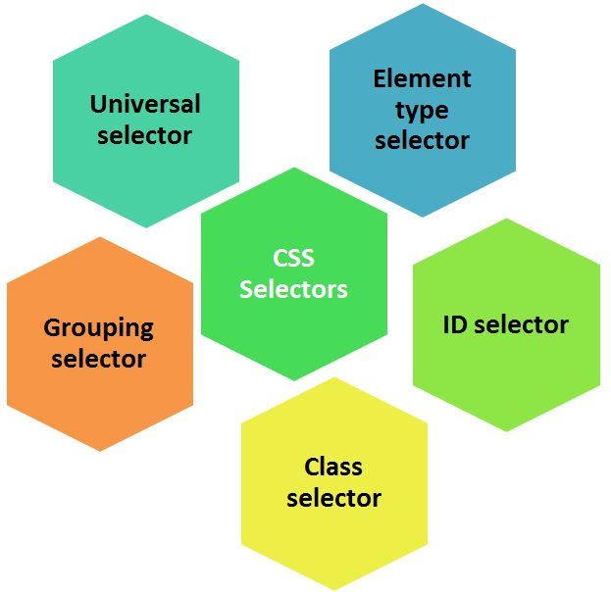

Slide 22

UNIVERSAL SELECTORS
Rather than selecting elements of a specific type, the universal selector quite simply matches the name of any element type
* {
color: red;
}
Output: This rule renders the content of every element in our document in black.

Slide 23
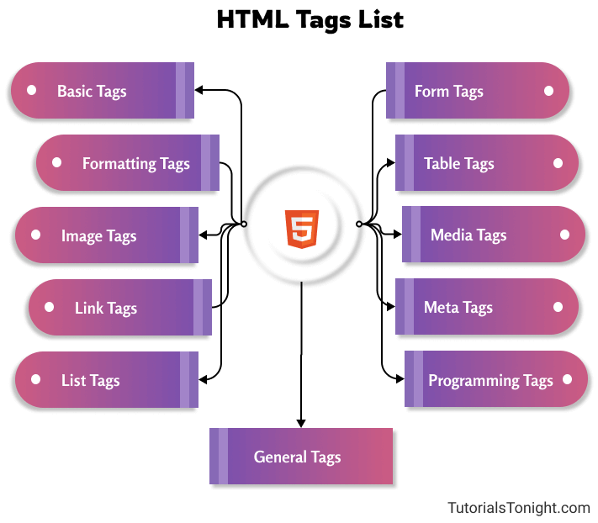
ELEMENT SELECTORS
The element selector selects elements based on the element name. You can select all p elements on a page like this (in this case, all p elements will be center-aligned, with a red text color).
p {
text-align: center;
color: red;
}

Slide 24
#
ID SELECTORS
The id selector uses the id attribute of an HTML element to select a specific element.
The id of an element should be unique within a page, so the id selector is used to select one unique element!
To select an element with a specific id, write a hash (#) character, followed by the id of the element.
The style rule below will be applied to the HTML element with id=”para1″:
#paragraph{
color: green;
text-align: center;
}

Slide 25
.
CLASS SELECTORS
The class selector selects elements with a specific class attribute.
To select elements with a specific class, write a period (.) character, followed by the name of the class.
In the example below, all HTML elements with class=”center” will be green and center-aligned:
.heading{
color: green;
text-align: center;
}

Slide 26
GROUPING SELECTORS
If you have elements with the same style definitions
h1,h2,h3 {
text-align: center;
color: blue;
}
p {
text-align: center;
color: blue;
}

Slide 27



Thank You

